Slide 1






Jarvis
Jarvis
The AI Co-Manager
That Beats the Market
Team 6
Future of Private Investment

Slide 2
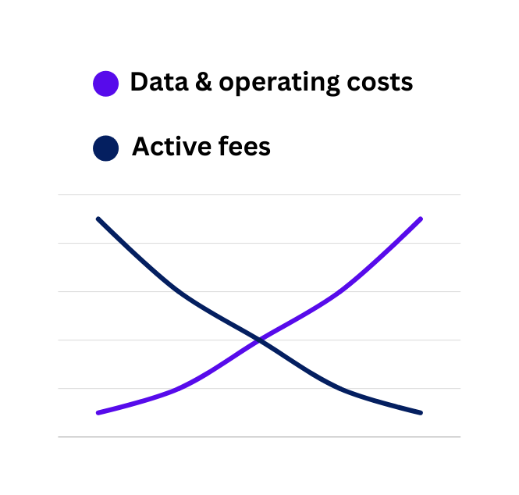
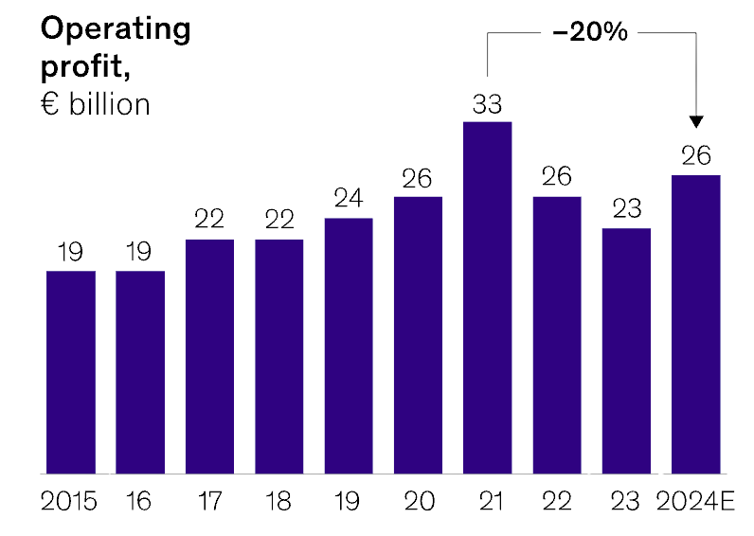
An Opportunity
Jarvis
Active managers are under pressure...
As a result...
Active managers have less margin to generate the same outperformance
Source: EFAMA (2024); Broadridge (2024); McKinsey Global Institute (2025)

Slide 3


The Problem
Jarvis
The competitive edge has shifted from data access to interpreting complex, forward-looking information
Financial statements & broker research
Unstructured
Fragmented
High-signal data:
patents, regulation, technical text, enterprise reporting, etc.
Costly
Source: EFAMA (2024); Broadridge (2024); McKinsey Global Institute (2025)

Slide 4


+
Javis
Our Solution
Jarvis
We turn hidden information into valuation insights
Decision support
Identify undervalued companies earlier and with higher conviction
Valuation integration
Signal generation
Semantic extraction
Data ingestion

Slide 5



How It Works
Jarvis
Real-time unstructured data is turned into valuation insights
Data Input
Data Process
Valuation
Output
Global trends
Unstructured data
Economically meaningful signals
Modeling with new data signal
Adjusted valuation
Discrepency value
&
Investment suggestion
Financial data
Modeling using Multiples
Feedback training data from market success/failure
Market price

Slide 6



Competitive Landscape
Jarvis
No existing solutions have our edge
Forward-looking
Alternative data providers
Jarvis
Unintegrated
Valuation-integration
Traditional financial data platforms
Other AI-driven analytics tools
Quantitative or factor-based systems
Current/Backward-looking
Source: Bright Data (2026); Bloomberg (2026)

Slide 7


Slide 8
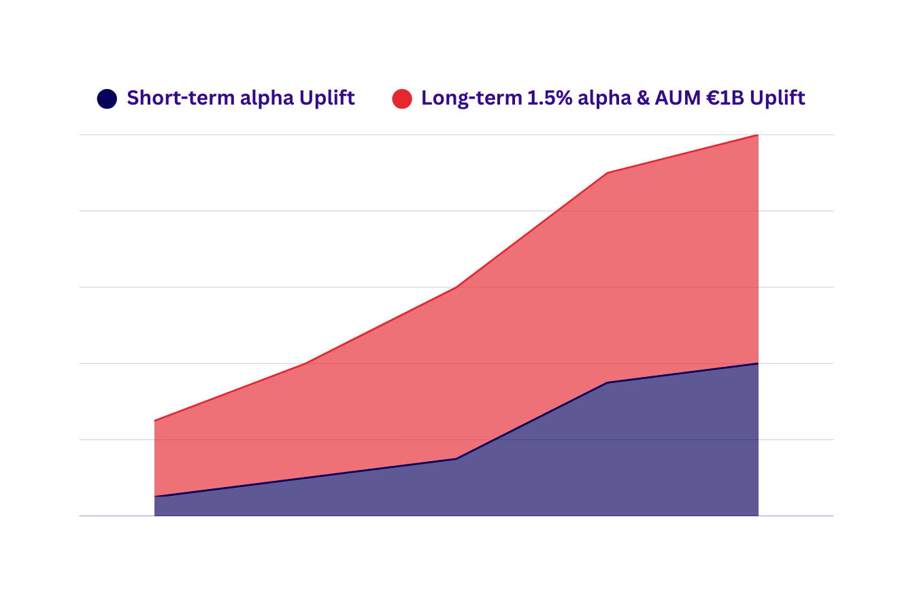




Value Creation
Jarvis
Creating value through better decisions
Early stock selection
Valuation-first integration
0.5%
0.8%
Long-term alpha &AUM Uplift
Continuous learning
0.5%
0.5%
0.8%
Short-term alpha Uplift
Scalable use of unstructured data

Slide 9



Our Roadmap
Jarvis
Our Roadmap
Our focus tasks for the next 3 months
MVP3
MVP2
  Expand data source
  Automated evaluation
  Lagged Signal Generation
  Time-Specific Expert Models
  Backtesting
Addressing forward-looking bias
MVP1
Jun. 1 - Sep. 31
MVP3
  Valuation integration
Mar. 1 - May. 31
Feb. 1 - Mar. 31

Slide 10






Team
Jarvis
We are a motivated team with technical rigor and sharp execution
Violet Si
Operational & Commercial Lead
Mohamed Raslan
Financial Lead
Sarbajit Chatterjee
Product Architect
Rushan Mukherjee
AI Expert
Dr. Ingolf Pernice
Industry Advisor
Financial modeller

Slide 11
A Call-to-Action
Jarvis
Support us to deliver you a solution that works!
10k EUR
Team
  AWS data infrastructure
  Bloomberg data
  Patent API
  Hire us for 3 months
  A committed member with financial modeling expertise

Slide 12
Appendix
Jarvis
References
  Broadridge Financial Solutions. (2024). US & European fund fee trends: Exploring a decade of transformation. https://www.broadridge.com
  EFAMA. (2024). European asset managers on course to manage €33 trillion. https://www.efama.org
  European Central Bank. (2024). Passive investing and its impact on return co-movement. https://www.ecb.europa.eu
  Hall, B. H., Jaffe, A. B., & Trajtenberg, M. (2004). Market value and patent citations. RAND Journal of Economics, 36(1), 16–38. https://www.nber.org/papers/w7741
  McKinsey & Company. (2025a). How AI could reshape the economics of the asset management industry. https://www.mckinsey.com/industries/financial-services/our-insights
  McKinsey & Company. (2025b). The European asset management industry: Navigating volatile times. https://www.mckinsey.com/industries/financial-services/our-insights
  Research and Markets. (2025). Alternative data market size, share and trends analysis report. https://www.researchandmarkets.com
  Deloitte. (2023). Generative AI in investment banking. https://www.deloitte.com

Slide 13


Jarvis
Thank you for your time!
Team 6
Future of Private Investment

Slide 14
Appendix
Jarvis
Prototype Link
https://jarvis-oddo.lovable.app/

Slide 16
Appendix
Jarvis
Real-time unstructured data is turned into valuation insights
Data Input
Data Process
Valuation
Output
Global trends
Unstructured data
Economically meaningful signals
Modeling with new data signal
Adjusted valuation
Discrepency value
&
Investment suggestion
Financial data
Modeling using Multiples
Feedback training data from market success/failure
Market price

Slide 17

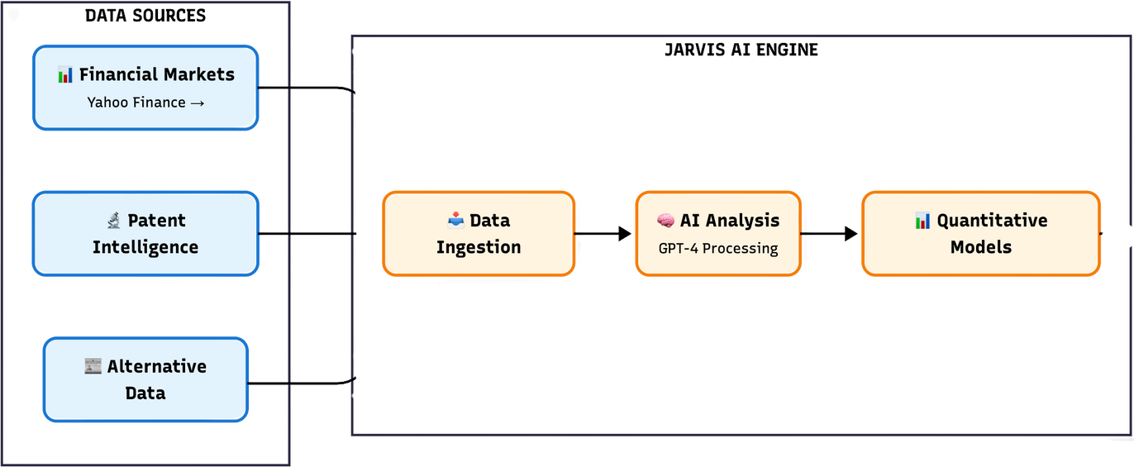
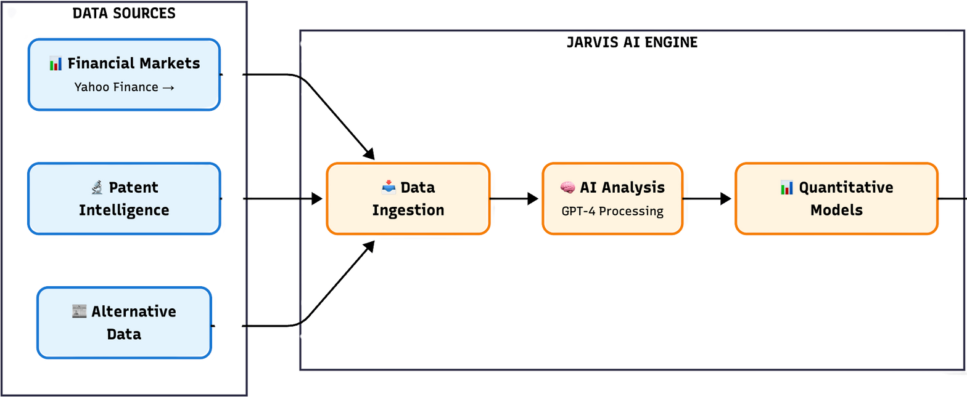
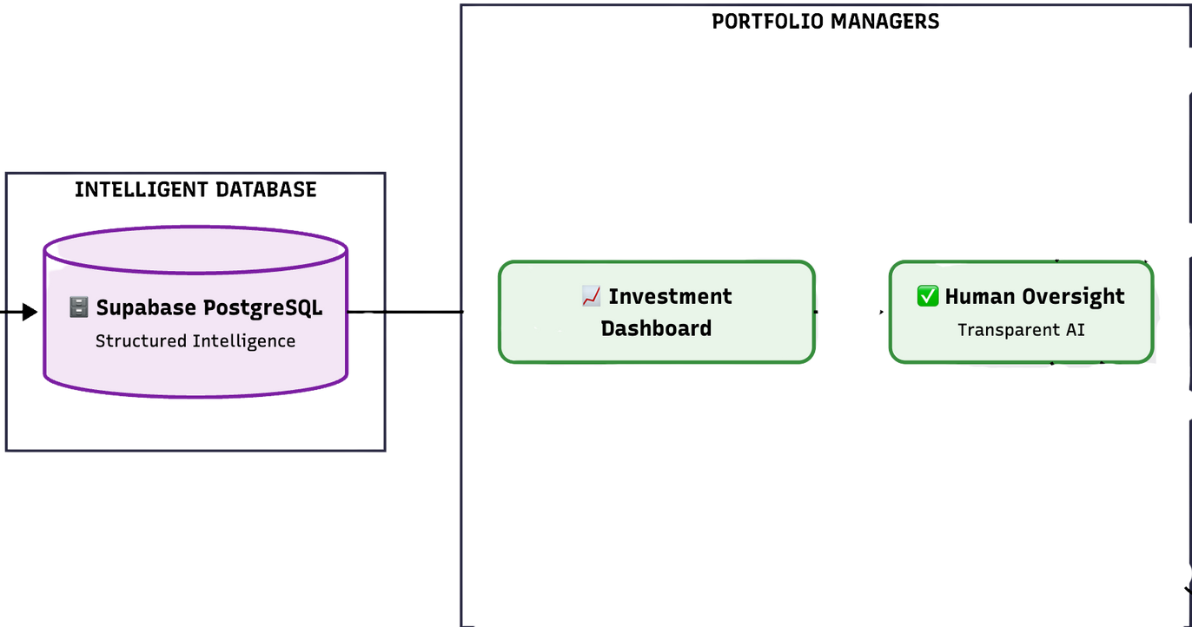

Appendix
Jarvis
Detailed explanation of current MVP 0
Data Sources
Jarva’s AI Engine
Output
Data Input
Data Process
Global trends
Intelligent Database
Unstructured data
Economically meaningful signals
Financial data
Modeling using Multiples

